Slide 1
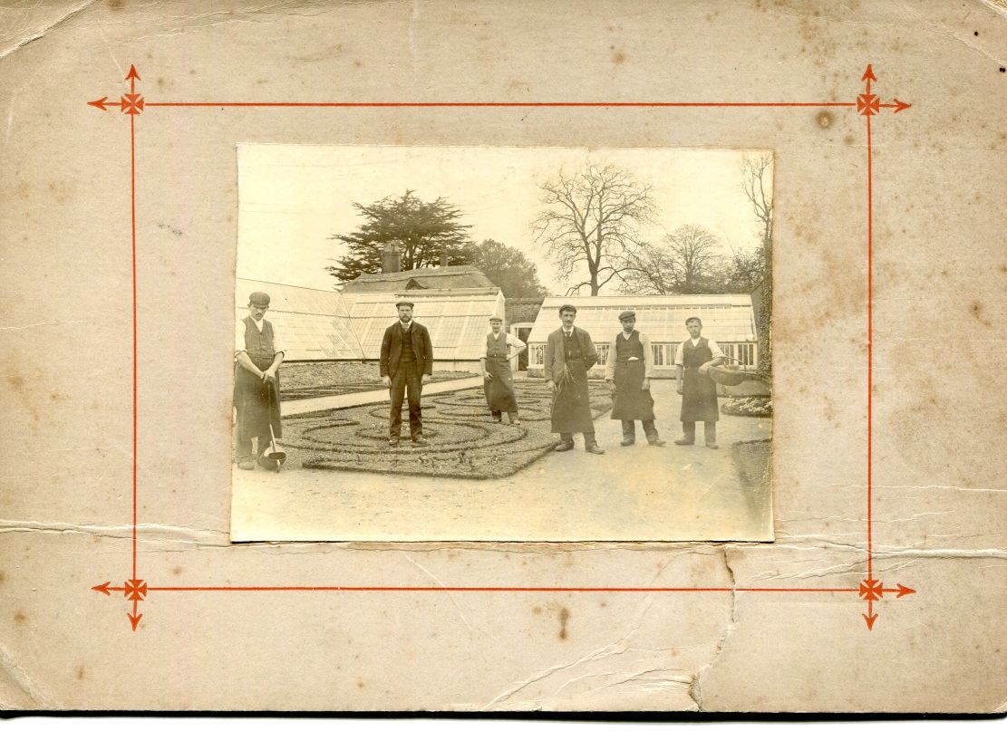
Woolverstone Village Meeting Wednesday 11th October 2017
Welcome

Slide 2
Babergh and Mid Suffolk Joint Local Plan consultation
Format of the evening:
Why the new Joint Local Plan?
How it effects Woolverstone
How you can take part
Opportunities for questions and discussion

Slide 3
Consultation time scale
21st August 2017 – 5 p.m. 10th November 2017
Email: localplan@baberghmidsuffolk.gov.uk
www.babergh.gov.uk/jointlocalplan or www.midsuffolk.gov.uk/jointlocalplan

Slide 4
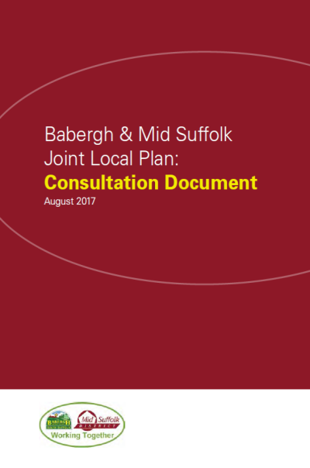
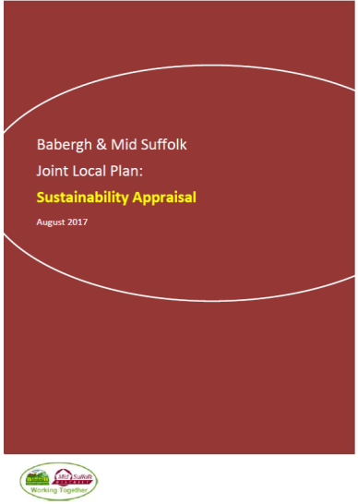
Why are we here this evening?...
Babergh and Mid Suffolk Joint Local Plan - Consultation Document (Reg 18 Stage).
The Plan The SA
Monday 21st August - Friday 10th November 2017.
Notes:
The Councils are currently consulting on the Babergh and Mid Suffolk Joint Local Plan - Consultation Document (Reg 18 Stage). A Sustainability Appraisal has been undertaken and accompanies the consultation document.
This is an important document which will provide the strategy for the growth of the Districts, setting out what and where development will take place up to 2036 (20 years ahead). A lot can happen in 20 years and we can’t predict everything but we need to establish a framework for future growth which will create places where we all want to live, work and spend time. The production of the Joint Local Plan is a balancing act – between meeting the need for housing, promoting growth in the economy, supporting our communities and protecting our environment. The Joint Local Plan must also be consistent with national planning policies. The Joint Local Plan can’t address everything – it is the spatial interpretation of the Districts’ aims and aspirations. The plan is a statutory document against which planning applications will be determined.
Residents, local businesses and stakeholders are being asked to have their say on the new Babergh and Mid Suffolk Joint Local Plan. Once adopted, the new Joint Local Plan will replace the existing local planning policies for both Babergh and Mid Suffolk. This is your opportunity to give your views on the Plan and the accompanying sustainability appraisal.
The process is iterative and the plan will evolve with options being refined and policies being developed to enable delivery.
This is an initial but very important stage and the responses to this consultation will be a significant influence on the final plan.

Slide 5
Why do we need a new local plan?
BDC no longer have a 5 year housing supply
The old Local Plan has not delivered enough housing to meet targets
The new Local Plan has to deliver a target number of houses 355 per year over the lifetime of the plan 2014 – 2036
79 Questions – not all of them relevant to Woolverstone

Slide 6
Delivery: Housing requirement
NPPF (para 47) local authorities should ‘…use their evidence base to ensure their Local Plan meets the full, objectively assessed need.’
Strategic Housing Market Assessment (SHMA):
Notes:
In the delivery sections the Plan articulates the issues and policies to influence delivery.
OAN has to be the starting point.
SHMA jointly commissioned with IBC, SCDC & WDC.
The SHMA concludes the above requirements for BDC & MSDC.
The current planned CS annual Babergh requirement is phased at 220 (2011- 2016) / 325 presently.
For MSDC 430 pa.
Delivering this rate has been challenging therefore the new level of OAN poses further challenge which the approach to be set out in the plan will need to address. This may be, for example planning contingency allocations as set out in Option HD1.

Slide 7
Update
Headline figure: 7,820
Objectively Assessed Need
Residual figure: 4,210
Takes in to account planning permissions already granted

Slide 8
Rural growth & development
Rural growth is vital to the Districts.
Delivery to date c. 60:40/ rural/urban.
Seeking to have a consistent and planned approach to delivery:
RG1 – A policy criteria based approach
RG2 – Allocations with flexibility for infill.
Notes:
Rural growth is essential to the Districts. Essential to supporting the communities, their services and facilities. To date the proportion of growth has been approx. 60:40.
The proportion of growth in rural areas in the future would be dependent upon the spatial distribution however there will need to be an agreed approach (regardless of the quantum) .
RG 1 – policy criteria similar to the BDC CS11 approach
RG 2 – allocations with flexibility for small scale infill. In this we have also sought to take forward an approach to enabling small scale growth in hamlets. This is something that a number of you have said you would like where there are clusters of housing. Criteria for consideration of this is also set out for consultation.
We also have further options set out in the plan concerning gypsy and traveller accommodation with options on how the sites could be allocated and also for caravans and houseboats. Further detail on this is set out in the consultation document.

Slide 9
Delivery – Economic Needs
Issues to be addressed include:
Employment land needs, requirements & way forward.
Town centres, retail capacity and allocations
Notes:
ELNA & SNA
Based on forecast jobs growth we effectively have a quantifiable surplus of land however it is not as simple as that. We need to marry up what land is required for the types of employment and whether what we have is fit for purpose. This will depend upon the employment sectors we are targeting and supporting for growth and development.
In the SHELAA there are assessments of potential employment sites which we would advise you review if any are in your area.
Town centres and retail are a key part of the economy – particularly with the network of market towns which span across the districts supporting the settlements in the wider rural hinterland. The (B & MS) Retail Study (2015) has made specific recommendations to support our town centres through providing a robust approach to restricting out of town retail as well as re-defining town centre and primary shopping areas and frontages. The details of this are set out in the consultation document and accompanying maps.

Slide 10
Delivery – Environment
Area is rich environmentally
Focus on:
Biodiversity
Climate change
Landscape
Heritage & Design
Notes:
We have great quality environmental assets. The options set out in the Plan focus on means of maintaining and enhancing them:
Biodiversity – the approach proposed seeks to ensure that all development provides appropriate protection with an inter authority approach to enabling enhancement.
Climate change – maintain the national approach to managing flood risk, particularly as we have sufficient land for development outside of zone 2 & 3 which is at risk of flooding. Renewable Energy – option of using the national approach as well as effectively tailoring this with criteria which will be used to consider the impact of proposed schemes – such as the impact on the landscape. An approach is set out for sustainability standards to tailor improved efficiency for water and energy.
Landscape – currently we have designated SLAs however the boundary of the areas is not necessarily robust or clear why it is in that specific location. The alternative approach set out in the plan seeks to raise the bar across the district, have a criteria based policy for considerations on managing landscape impacts as well as supporting the policy with supplementary planning guidance.
Heritage – national policy has strong provisions for protection. We are also proposing measures for the protection of non designated heritage assets with explanation of the types of assets that could be considered as this may be helpful to build in consistency in the approach across the districts.

Slide 11
Delivery – Infrastructure
Managing the cumulative impact of development
3 priority themes:
Health
Education
Transport
Notes:
It is imperative that development is supported by infrastructure. There are mechanism in place, be it CIL, S106 and planning obligations, which can help achieve this. CIL enables a strategic approach to be taken however for proposals that require infrastructure to be delivered through planning conditions or obligations it is essential to ensure that this is done within the parameters of pooling restrictions and or that there is the ability to manage it collectively – potentially through restricting or sequencing delivery until such as time as the cumulative impact can be addressed. The plan contains a policy approach to enable this.
All infrastructure is important however we are aware that across the Districts health, education and transport are often identified as priorities. The Councils do not directly provide this infrastructure themselves. We need to ensure that our policies have the provision to help support the delivery of these provisions and we are liaising with the providers to ensure that we mutually supportive in our respective plans.

Slide 12
Place
Functional Clusters
Settlement Boundaries
Potential Land for development & the SHELAA
Notes:
Functional clusters – we continue to recognise the spatial geography of the area with the networks of higher and lower order settlements and their relationship with the rural hinterland. There is a topic paper on this in the evidence information on the plan which sets out the review we have undertaken of the clusters and we are seeking your views on this.
Settlement Boundaries – for planning purposes settlement boundaries provide definition and clarification on the form of settlements and when development can be acceptable in principle. Many of the boundaries in the existing local plans are out of date and do not reflect the reality of the places they define. Therefore we have reviewed settlement boundaries and or added boundaries for settlements which did not previously have them for all settlements over 10 dwellings. Again we are seeking your views on the proposed approach and also on the boundaries.
Potential land for development – In due course the plan will allocate land for development (the location of which will be determined through the identified spatial distribution options as discussed at the start of this presentation). At the moment we have identified indicative locations which have been drawn from the SHELAA. You may recall that there were 2 call for site exercises back in 2014 & 2016 and the submissions from these exercises have been included within the SHELAA assessment. We are seeking your views on the identified indicative sites and also whether there are other sites which should be considered.
This is a substantive part of the plan therefore I shall talk you through how to view the sites on the mapping system before I come onto closing and explaining how to comment on the plan.

Slide 13
How will this effect Woolverstone?
What is most important for our village over the next 18 years?

Slide 14
How will this effect Woolverstone?
Settlement hierarchy criteria.
Woolverstone has been allocated 11 points. We believe it should only be allocated 8 points.
We have 2 points for being within 5 km of Ipswich. We are in fact 7.8 km from Ipswich.
We have been awarded 1 point for having allotments. The allotments are closed by the Diocese to new tenants. Effectively we don’t have allotments.
This matters.
8 points would make us a Hamlet which has implications for future development.

Slide 15
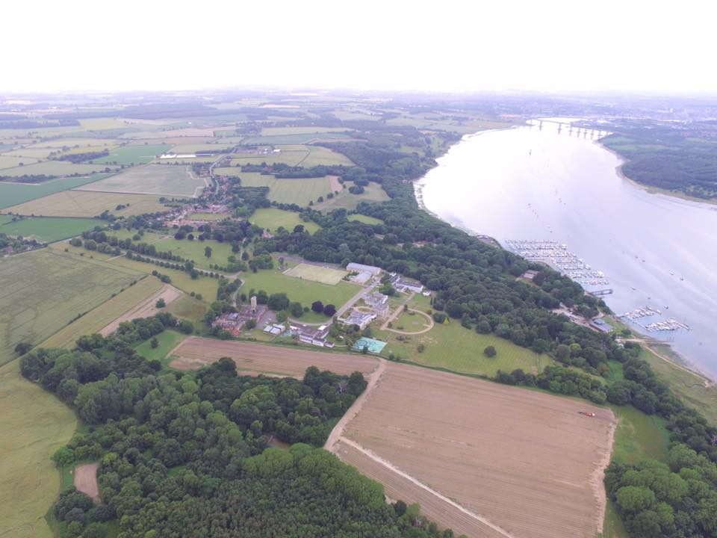

Slide 16
How will this effect Woolverstone?
Woolverstone designated a Conservation Area in 1989
Conservation Area Appraisal adopted by BDC in 2008
Everything North of B1456 in Suffolk Coasts and Heaths Area of Outstanding Natural Beauty
All village in Suffolk Coasts and Heaths Area of Outstanding Natural Beauty project area
Contains 18 listed buildings: Woolverstone Hall, Widows Homes, Woolverstone House, Walled Garden, Berners Hall, War memorial, Holbrook Lodge, Stone cottages
Only example of Ancient Estate farmlands to be found in Babergh district

Slide 17
How will this effect Woolverstone?

Slide 18
How will this effect Woolverstone?

Slide 19
How will this effect Woolverstone?
SS0203 – recommendation for 10 houses
Greenfield site
Grade 2 listed agricultural land
Area identified for building is within Conservation Area
Site was rejected in 2016 “inadequately related to services, facilities…”
SS0255 – recommendation for 2 houses
Greenfield site
Grade 2 listed agricultural land
Area identified for building is within Conservation Area
Currently has a covenant to protect it
Site was rejected in 2016 “inadequately related to services, facilities…”

Slide 20
How will this effect Woolverstone?
Land North of B1456 rejected as in AONB
Permitted Development Rights:
White House Farm has been granted permission for developing redundant farm buildings into 7 dwellings.
Home Farm has registered an application to convert redundant farm buildings in to 4 dwellings and with some employment use.

Slide 21
How will this effect Woolverstone?
Infrastructure
Transport: B1456, Freston crossroads, Wherstead roundabout
Healthcare: Surgery
Power: Electricity outages, no gas
Communications: Broadband, Mobile phone coverage

Slide 22
How will this effect Woolverstone?
Settlement boundary
A settlement boundary is normally a line drawn around a settlement in the Proposals Map of a Local Plan. The Local Plan generally allows for development within the boundary and resists development outside.
The proposal to move the settlement boundary round Dairy House and Thatched Cottage could have implications on the desire of the owner of the Walled Garden build within the walled garden area and the loss of integrity of a Grade 2 listed structure linked to the Hall and the Park.

Slide 23
How will this effect Woolverstone?

Slide 24
How will this effect Woolverstone?
How will this effect the Peninsula?

Slide 25
How will this effect Woolverstone?
Shotley Peninsula cluster?
The Shotley Peninsula has been identified as a unique area of landscape by BDC
Projected 11% of housing development over the next 18 years
If all the building identified in the NLP were to happen there would be an increase of at least 2000 people on the Peninsula
We think the Peninsula should be viewed as an entity and strategic planning safeguard its beauty.

Slide 26
What’s next?
You can take part in the consultation process:
On line interactive consultation
Or;
Email
Paper response – using pre-printed form or letter

Slide 27
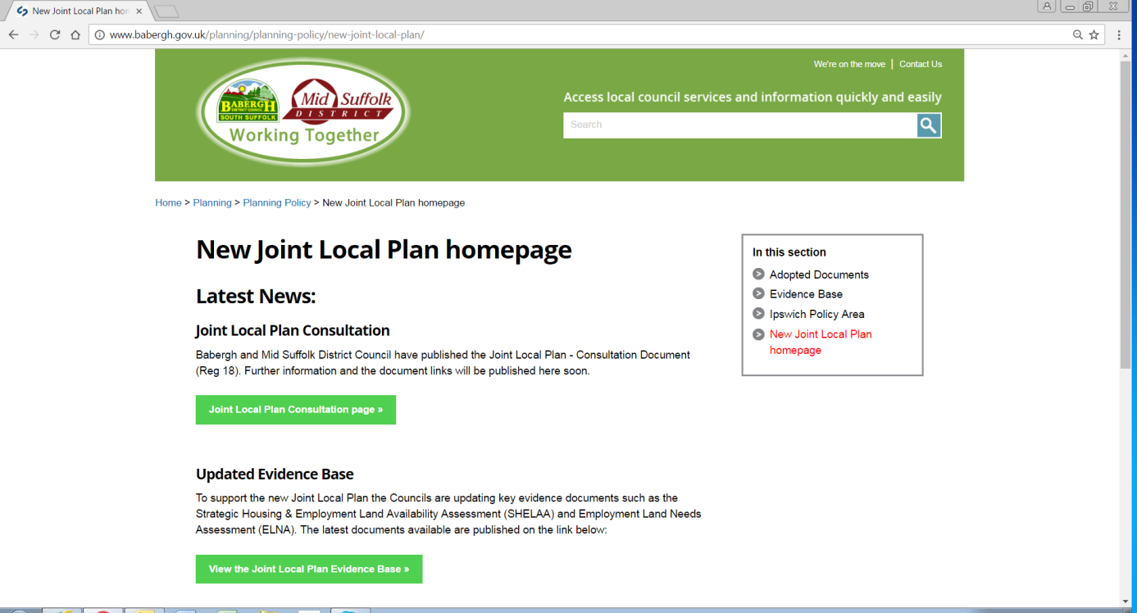
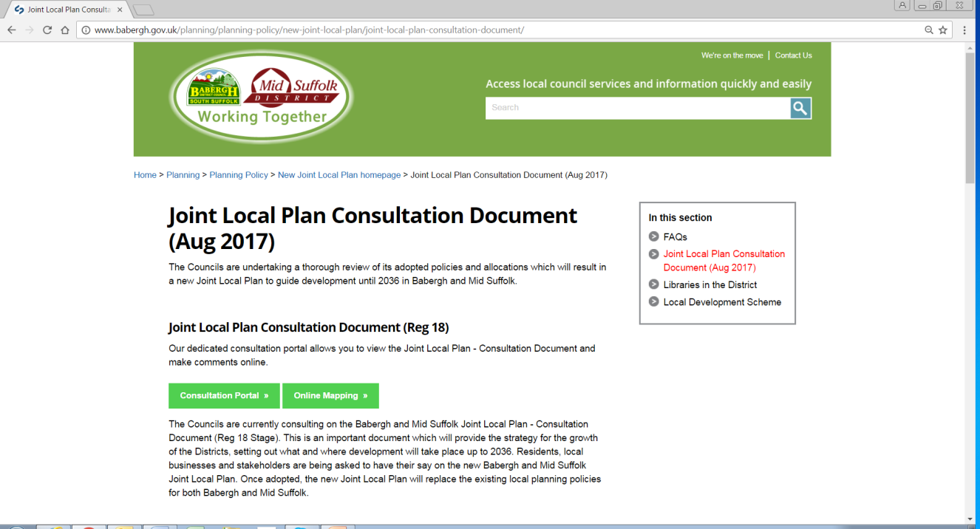
Online website information
www.babergh.gov.uk/jointlocalplan
www.midsuffolk.gov.uk/jointlocalplan
Access to:
Consultation Portal – online comments
Online mapping – view sites/boundaries
Public event dates and venues
Published document locations

Slide 28
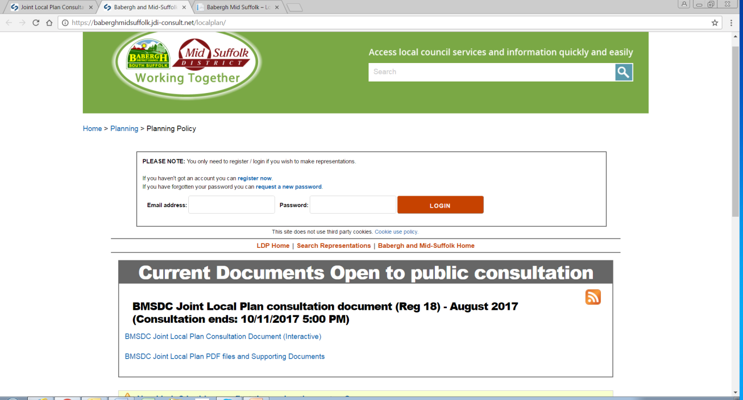
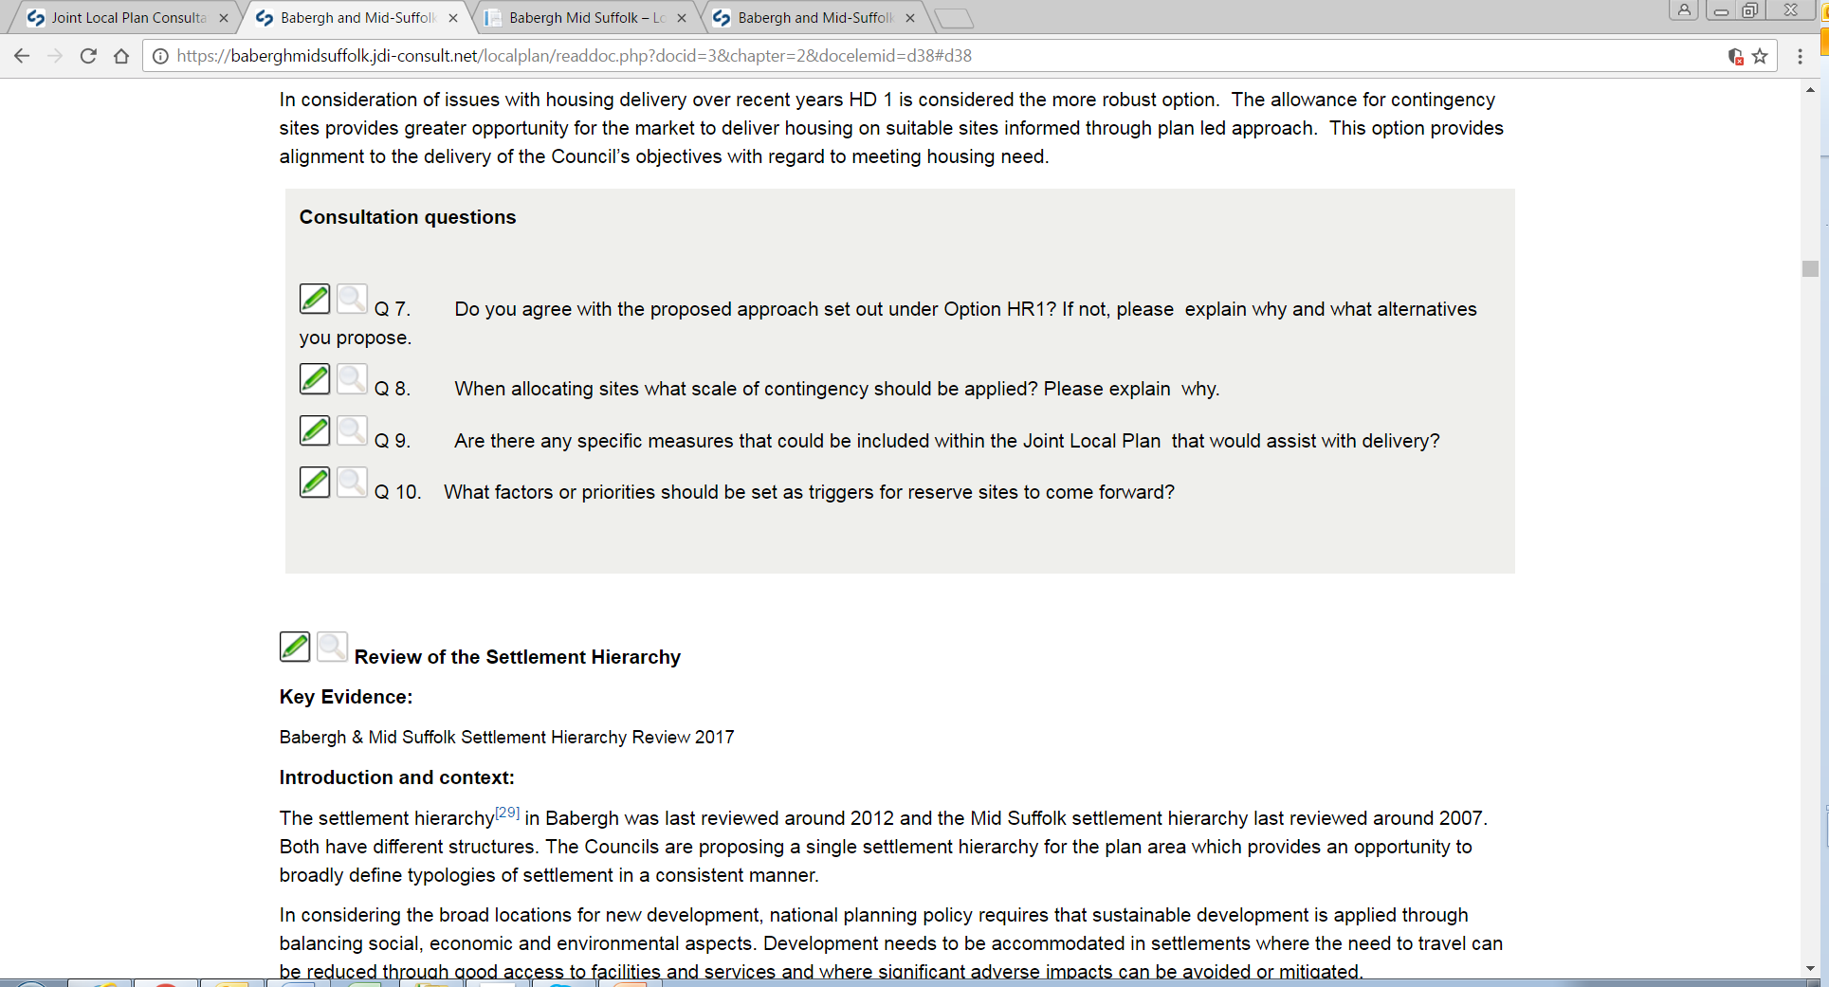
Online consultation system
Interactive online
Joint Local Plan
document
Notes:
Using the online consultation system will ensure that we accurately identify the part of the Consultation Document that you are commenting on.

Slide 29
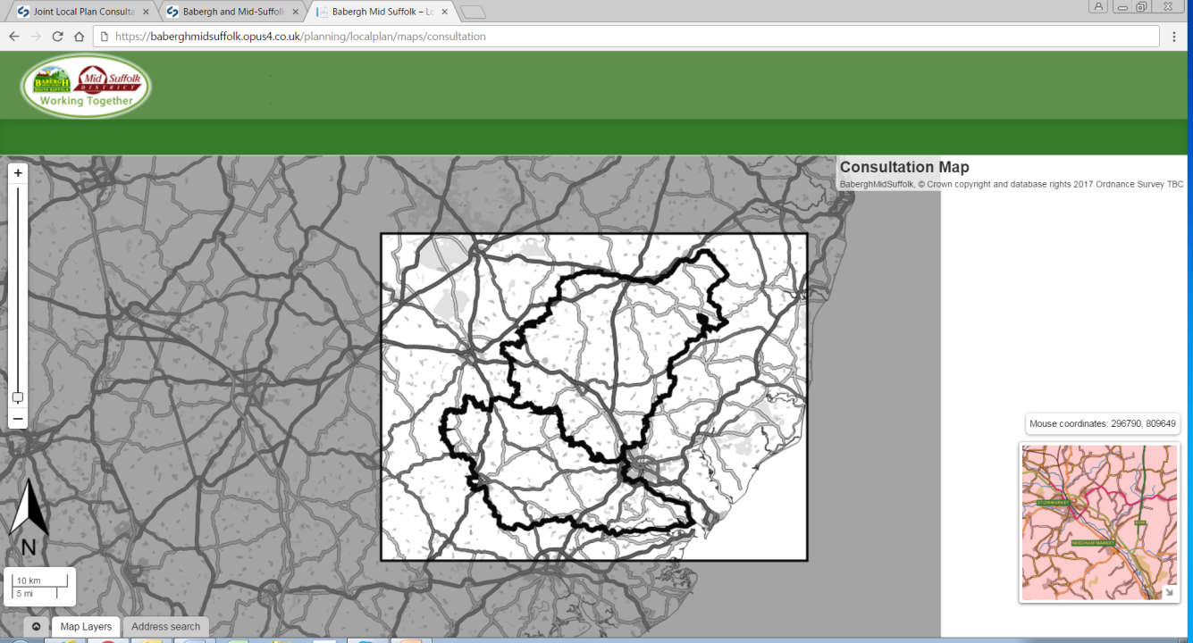
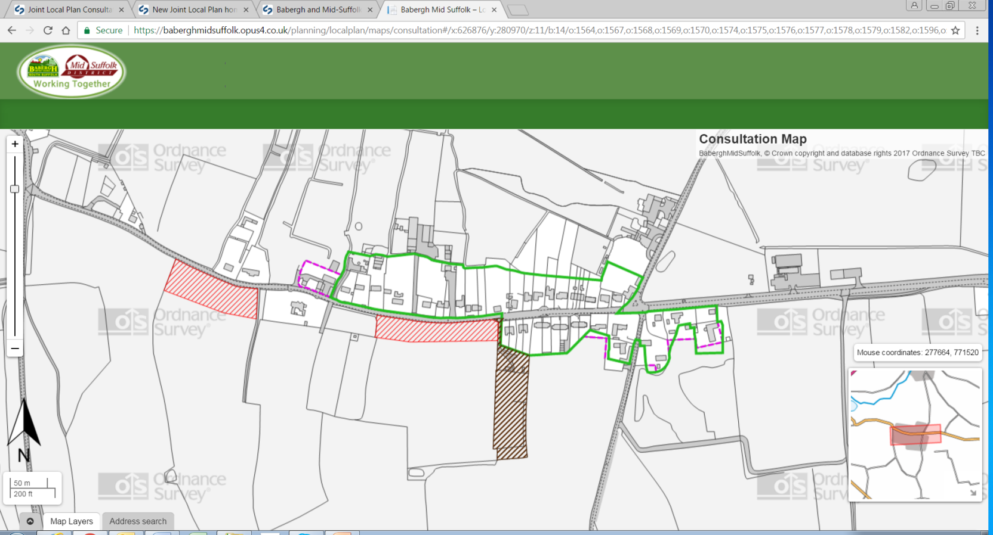
Online mapping tool
SHELAA sites
(both potential and discounted)
Settlement boundaries
(existing and proposed)
Town centre boundaries
(existing and proposed)
Notes:
Show where the zoom in and out scroll is. Explain the colouring. Explain that by clicking on sites you can make comments (and I will show you shortly what that page looks like).

Slide 30
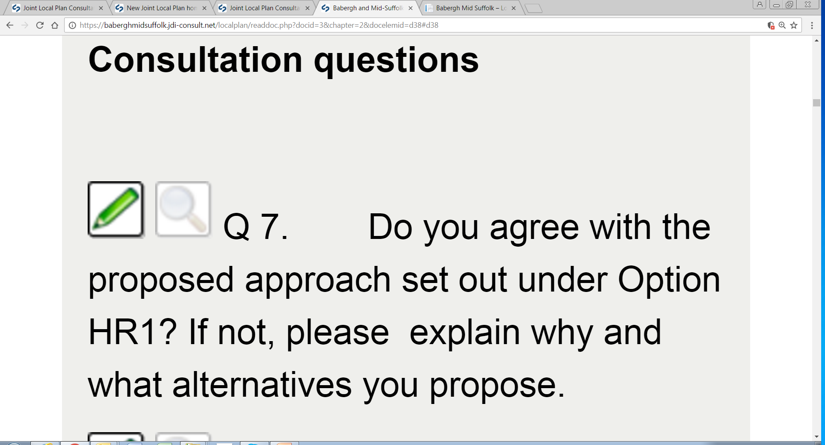
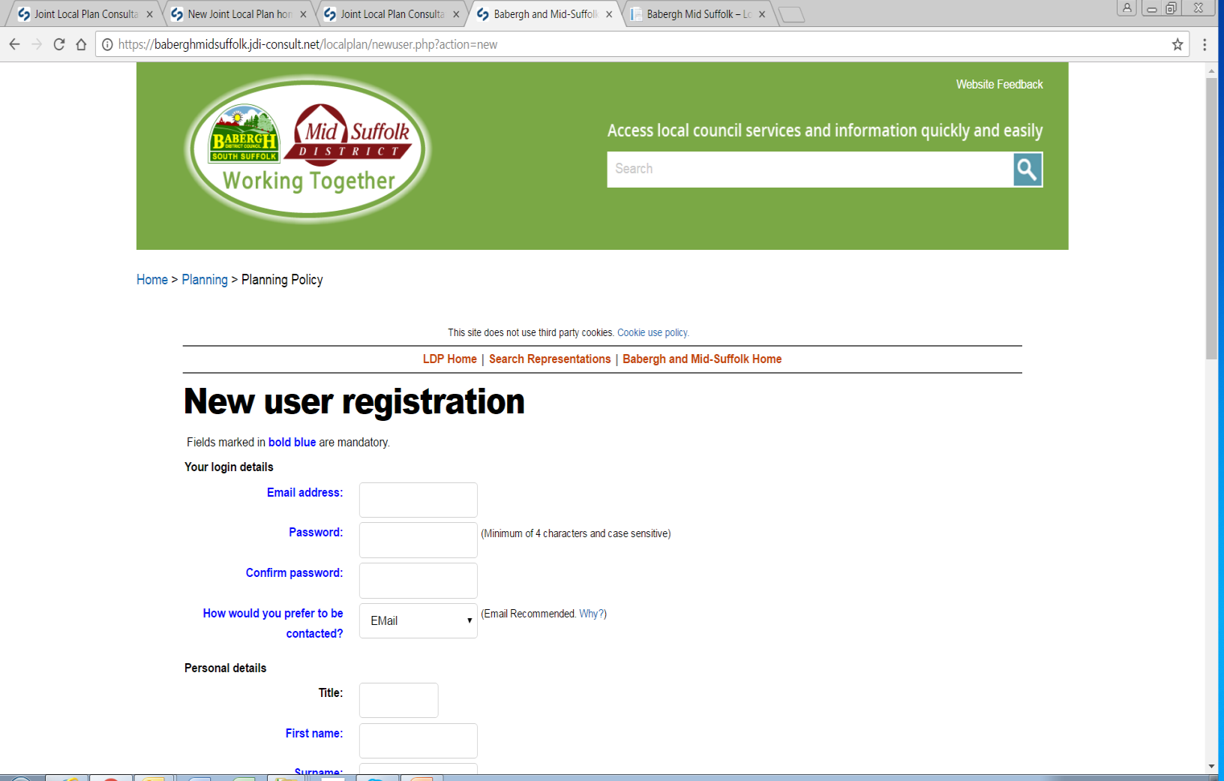
Making document comments online
Click pen icon next to specific
question or document text you
want to comment upon.
If not already registered or logged in, you will be prompted to enter your details.
Return to the pen icon to then bring up comment box for that part of the document.

Slide 31
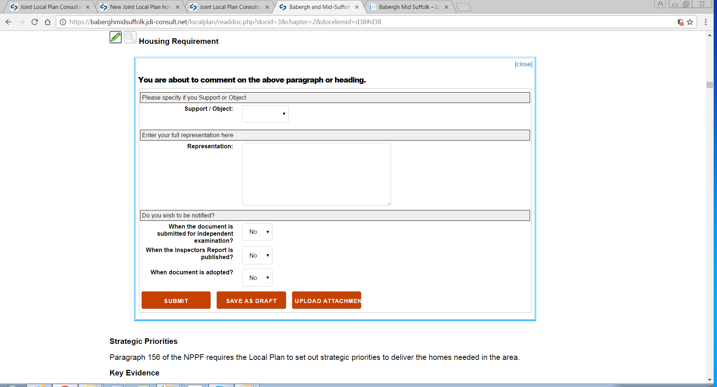
Making document comments online
Online consultation comment box

Slide 32
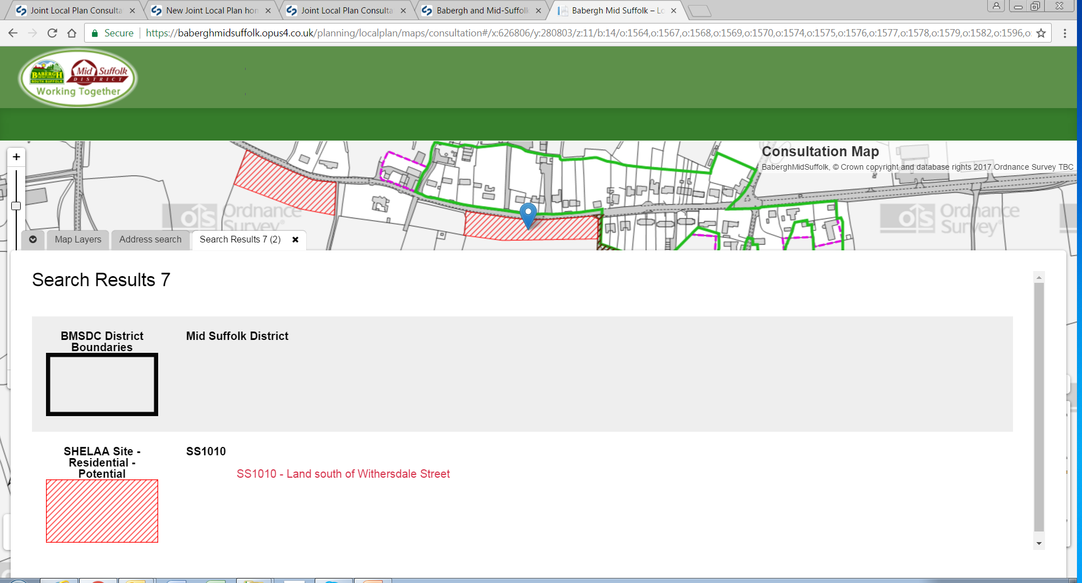
Making site / boundary comments online
Double click on a site, information will appear about the site(s) (type and status of site, site reference and site location). Click on the red site location text to be taken through to the interactive online system to make comments on the site.
The same approach applies to comments on proposed settlement boundaries.

Slide 33
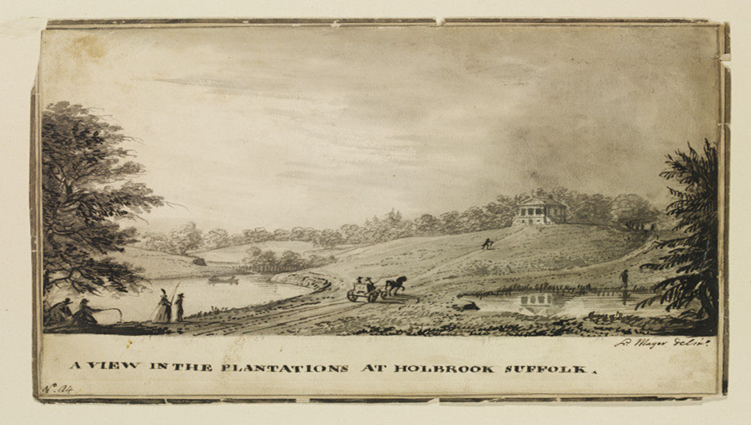
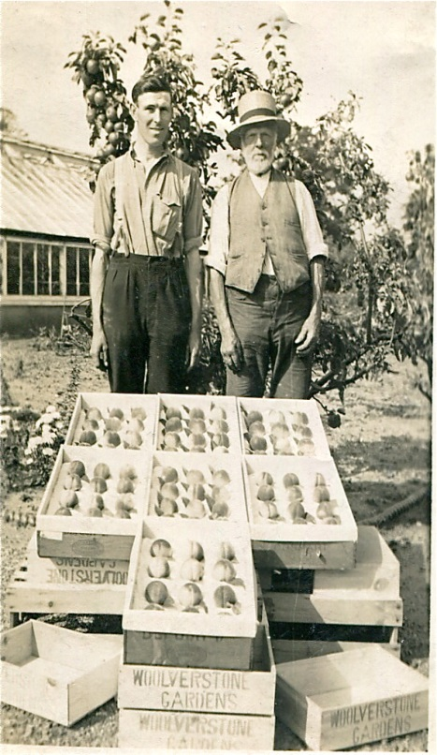
Any questions? Any points for PC?
Written questions?
Email me: simonrpearce@gmx.co.uk
Thank you

